Slide 1
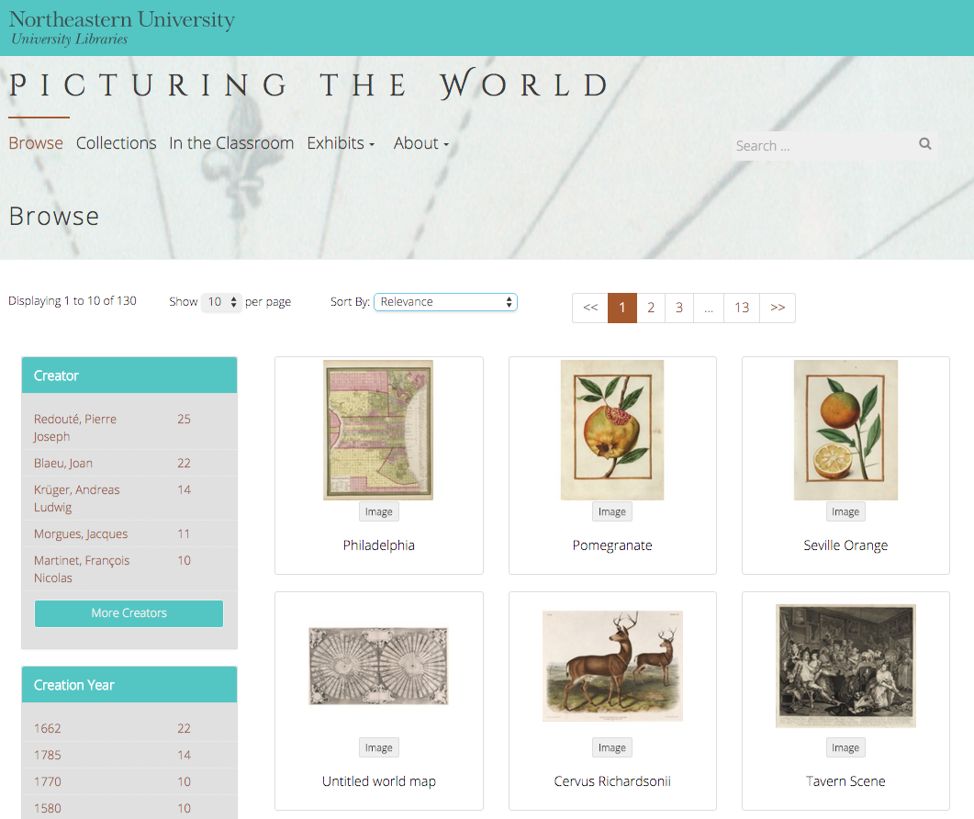
The DRS Project Toolkit
Sarah Sweeney
Digital Repository Manager
Northeastern University Libraries
Notes:
Promotional Slide

Slide 2
Ceres: Exhibits
Sarah Sweeney
Digital Repository Manager
Northeastern University Libraries
Notes:
Promotional Slide

Slide 3
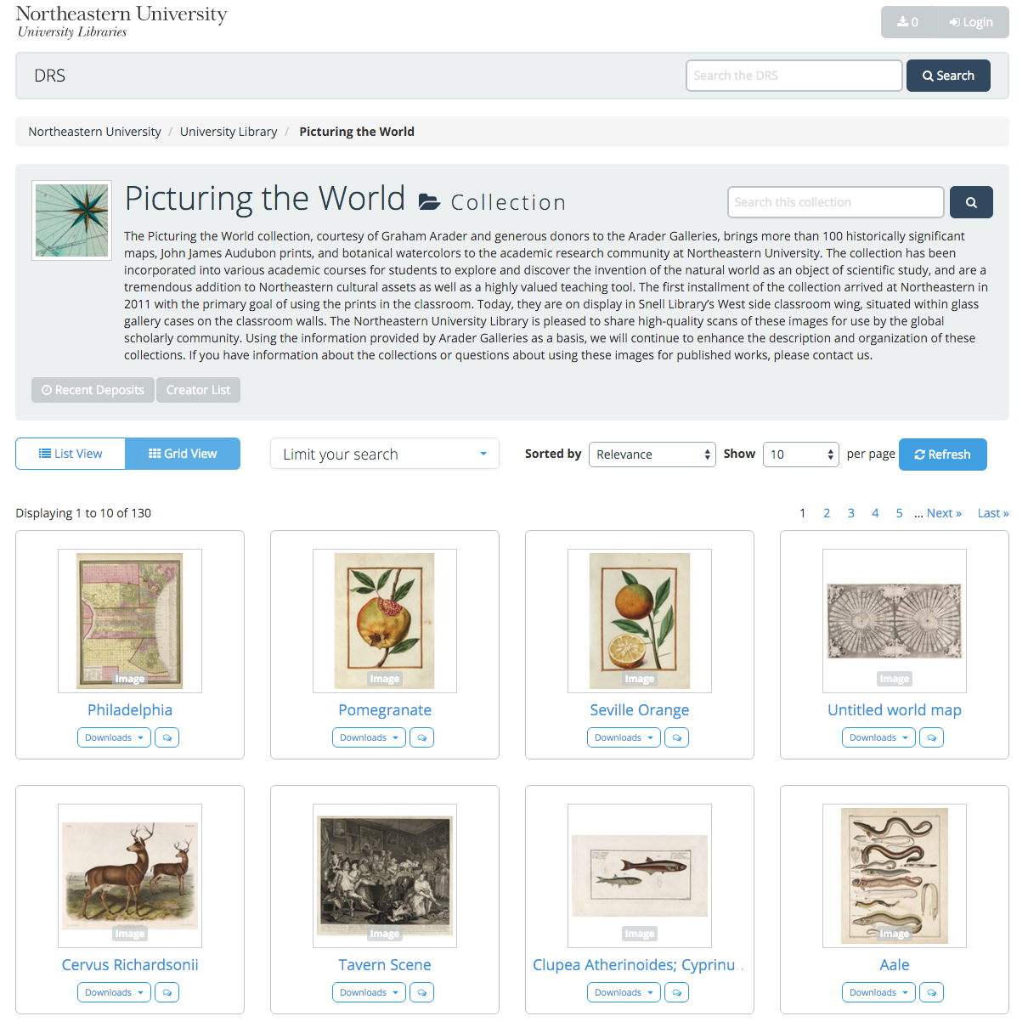
Digital Repository Service
DRS Project Toolkit

Slide 4

DRS
Resources
Contact
https://repository.library.northeastern.edu
http://dsg.neu.edu/resources/drs
sj.sweeney@neu.edu
Sarah Sweeney
Digital Repository Manager
Northeastern University Library
repository.library.northeastern.edu
Notes:
Promotional Slide

